Slide 1






ESP8266 WORKSHOP
Exploring how NodeMCU is use to become IoT

Slide 2
WHAT IS INTERNET of THINGS?
Network of interrelated devices that connect and exchange data with other IoT devices and the cloud.
IoT are typically embedded with technology such as sensors and software.
Network of interrelated devices that connect and exchange data with other IoT devices and the cloud.

Slide 3
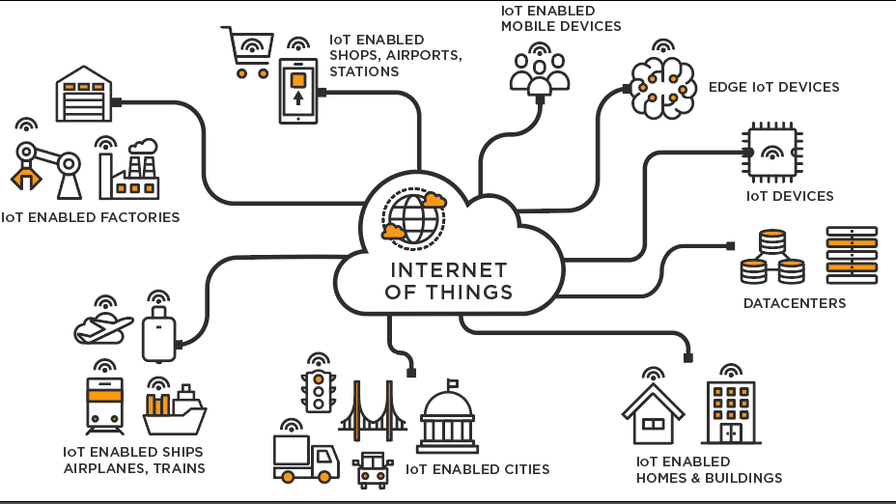

Slide 4

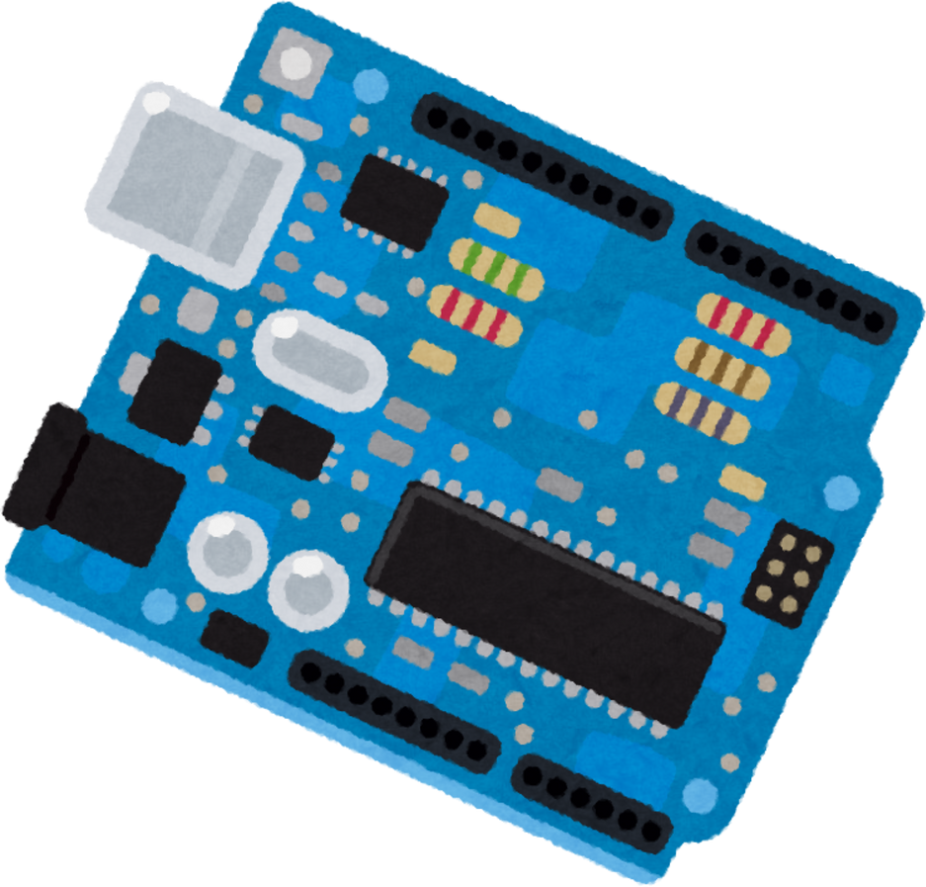

MAKING THE NodeMCU AS IoT

Slide 5
WE NEED 4 STEPS
TO ACHIEVE OUR MISSION...
1.Toggling the on-board LED of NodeMCU.
2.Connect the NodeMCU to WiFi.
3.Making the NodeMCU as an access point.
4.Connect the NodeMCU to the Firebase.

Slide 6


Today’s Focus
ESP8266
FireBase
Internet of Things (IoT)

Slide 7
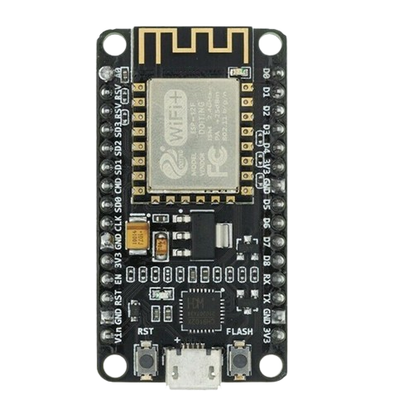
WHAT IS NODEMCU ESP8266 ?
NodeMCU ESP8266 is a low cost open source firmware.
Specifically used for IoT applications.
WiFi enabled microcontroller board.

Slide 8
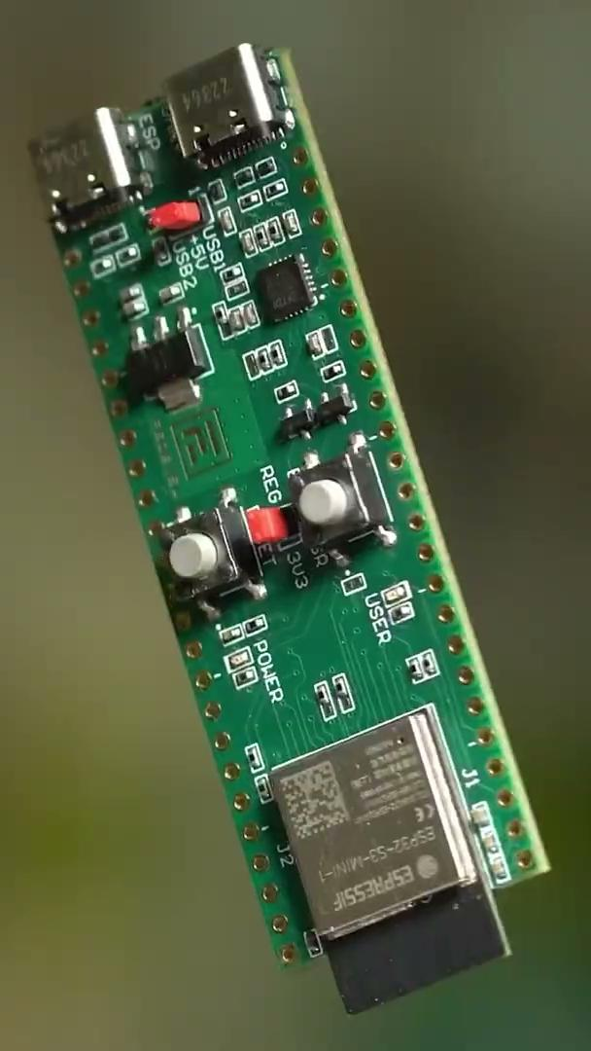
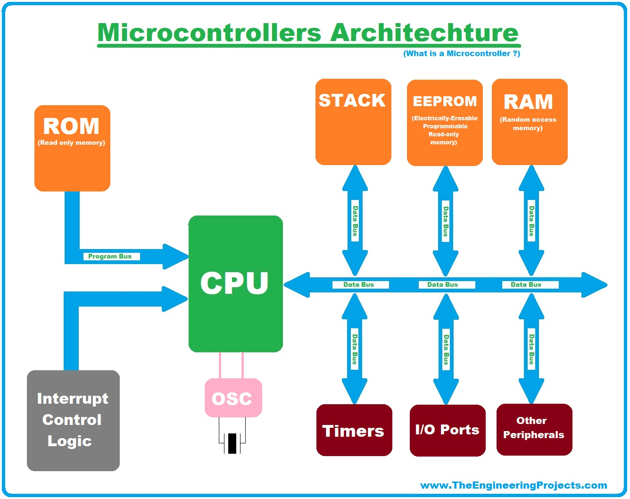
WHAT IS NODEMCU ESP8266 ?
WHAT IS NODEMCU ESP8266 ?

Slide 9
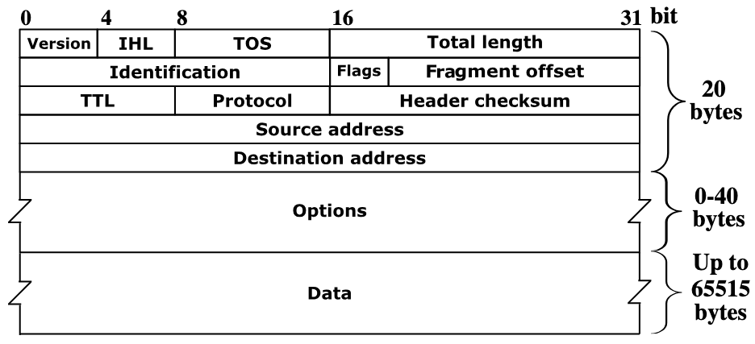
IP4

Slide 10

SETTING UP ESP8266 TO ARDUINO IDE

Slide 11
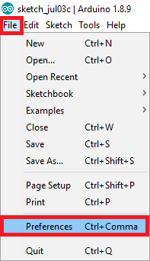
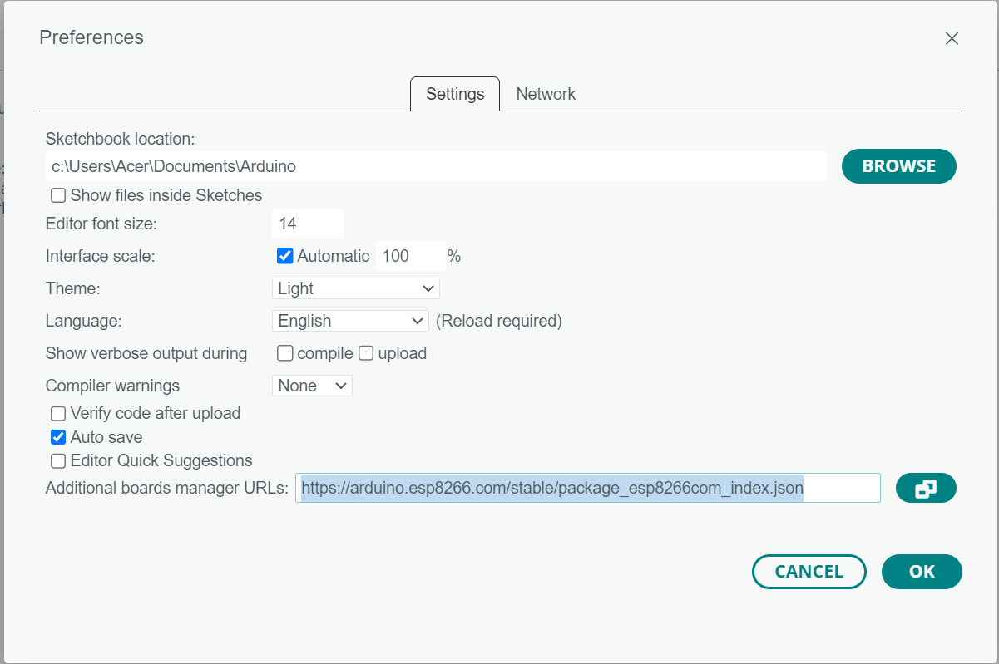
Go to File > Preference
2
In Additional Board Manager URLs, insert this link (https://arduino.esp8266.com/stable/package_esp8266com_index.json)
1

Slide 12
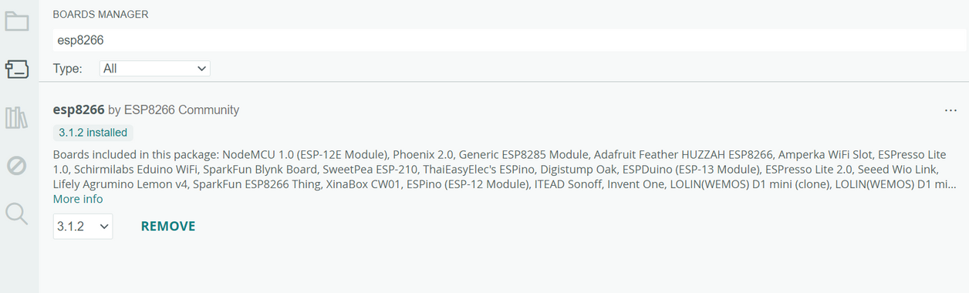
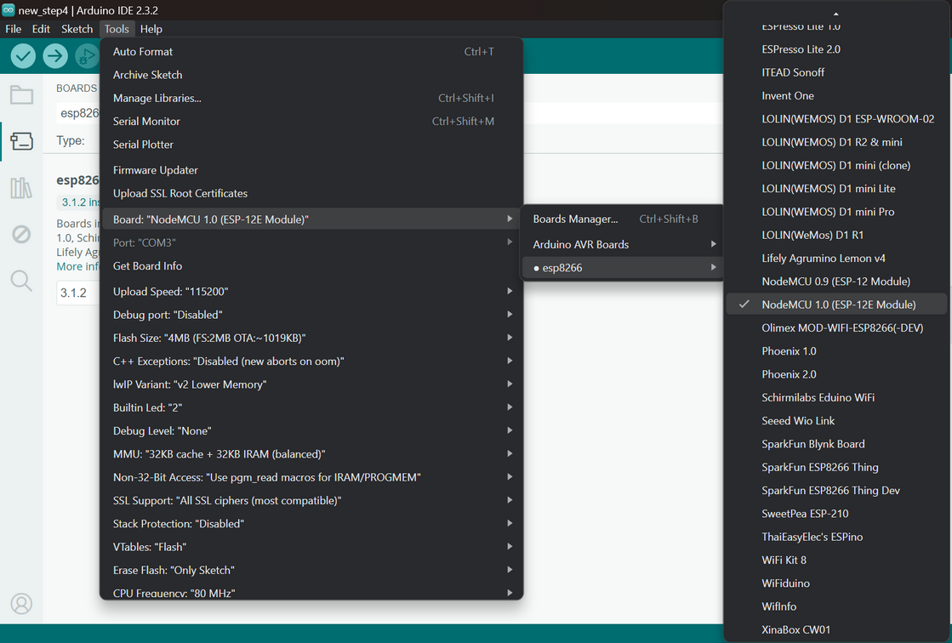
3
Go to Tools > Board >Board Manager
Search for esp8226 by ESP8266 Community and Install
4
Go to Tools > Board > esp8266 > NodeMCU 1.0 (ESP-12E Module)

Slide 13
SETTING UP FIREBASE WITH IDE

Slide 14
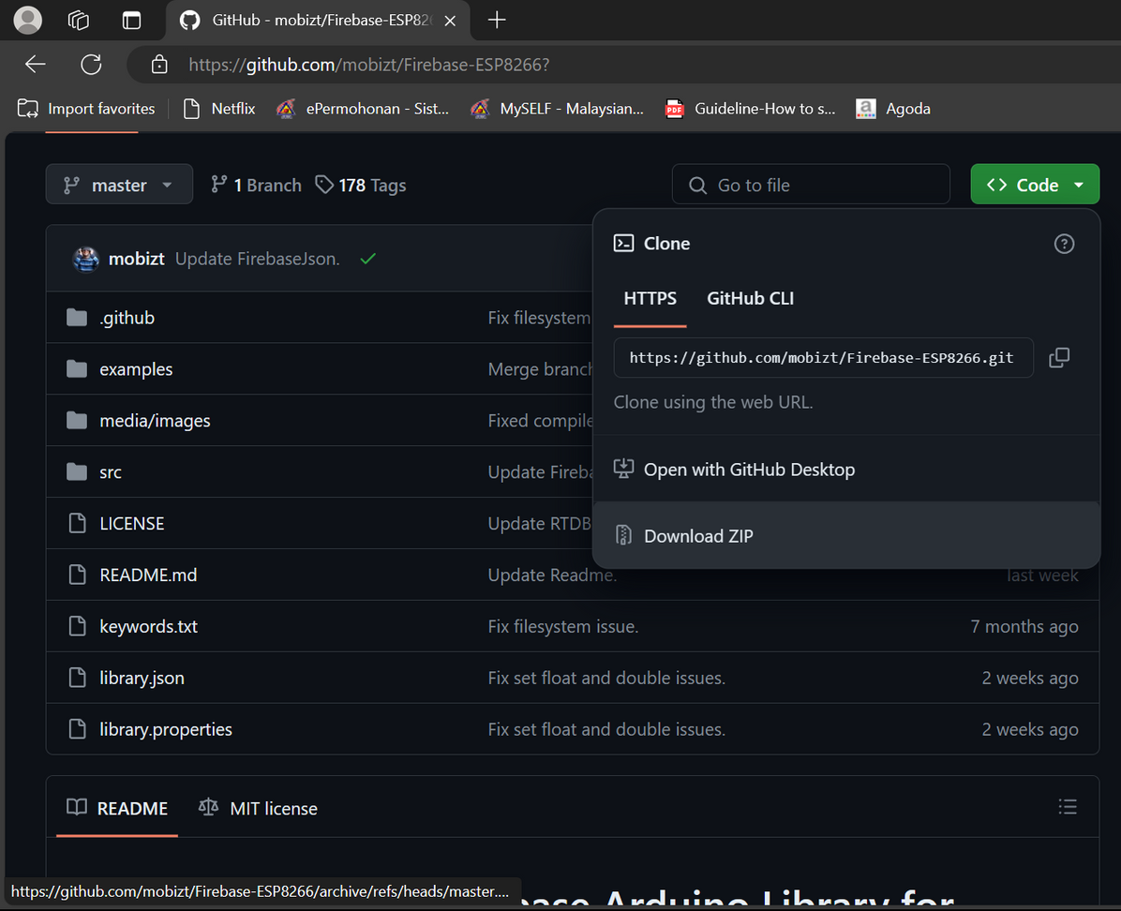
1
Download zip file from : https://github.com/mobizt/Firebase-ESP8266?

Slide 15
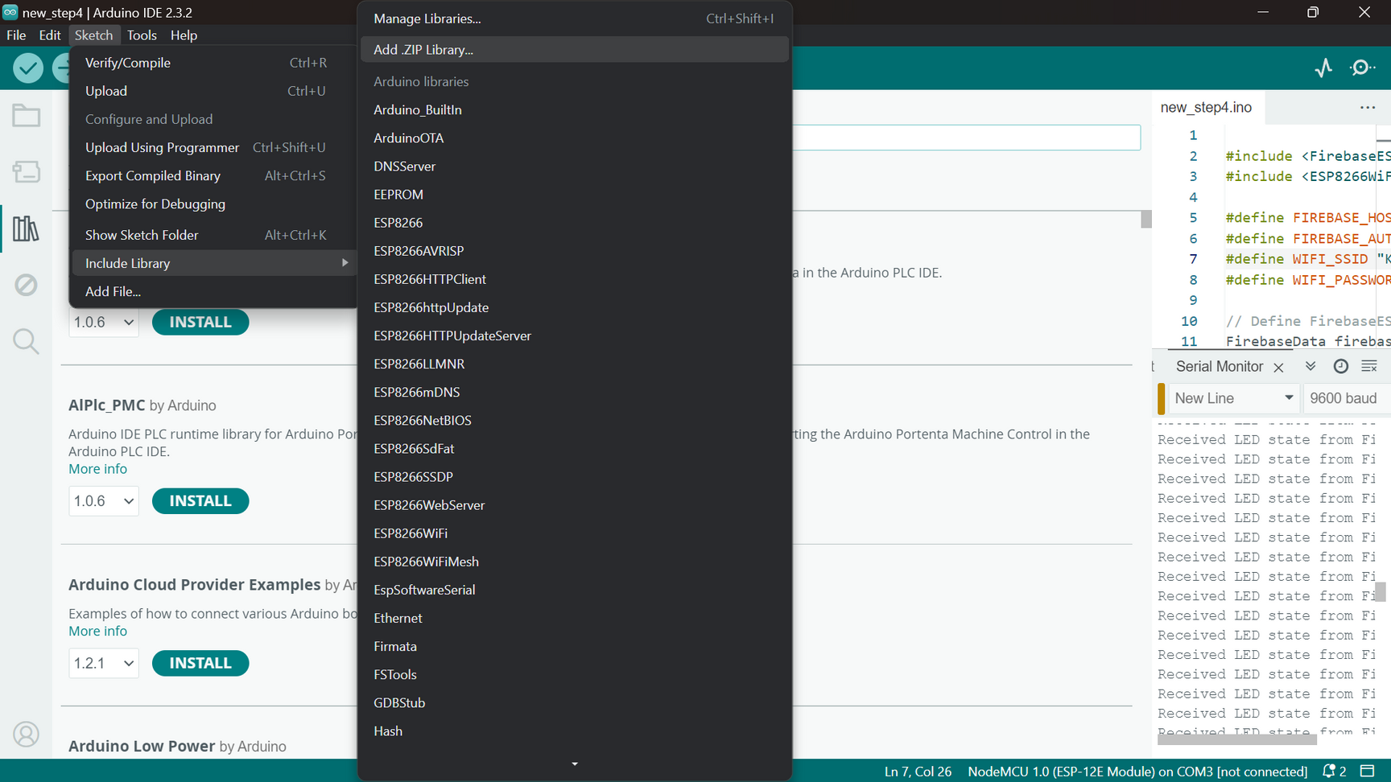
2
Go to Sketch > Include Library > Add .ZIP file

Slide 16
SETTING UP FIREBASE CONSOLE

Slide 17

WHAT IS FIREBASE ?

Slide 18
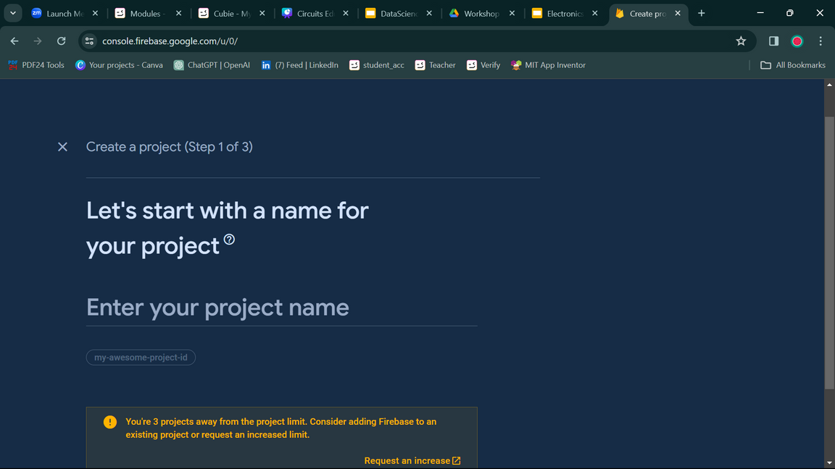
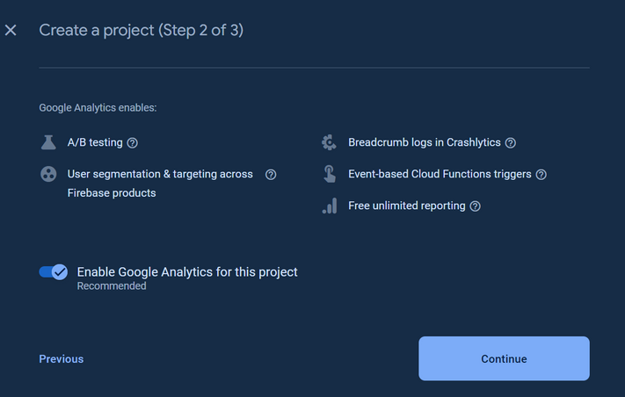
1
Go to Firebase console on google > create account
2
Once you’ve created an account, Click on Add Project.
3
Create a name for your project.
4
Enable the google analytics button and continue

Slide 19
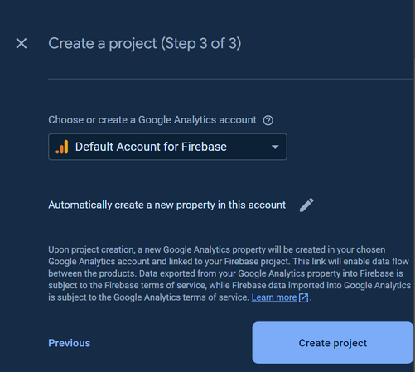
5
Setup or choose a Google Analytics account then press continue.
6
Go to Build > Realtime Database > Create Database
7
In set up database > database options: choose the nearest location for the realtime database. Then, press next.

Slide 20
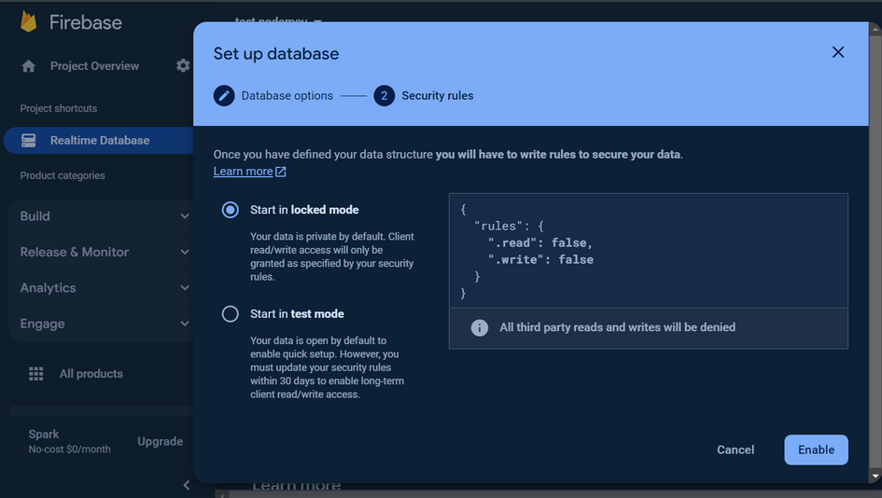
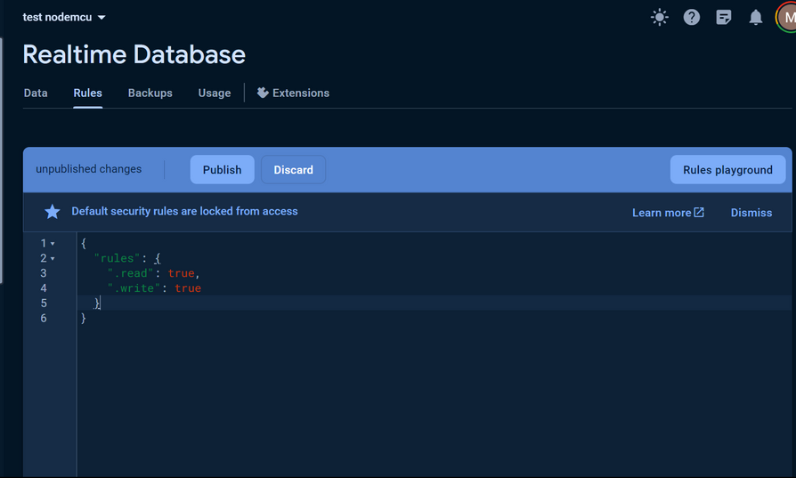
8
In set up database > security rules > choose the start in locked mode and clicked enable.
9
In rules, change the code from false to true. Then click Publish.

Slide 21
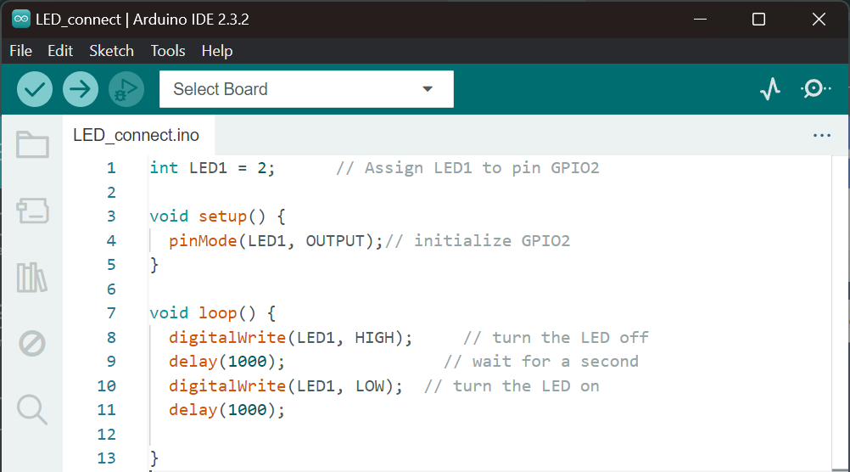
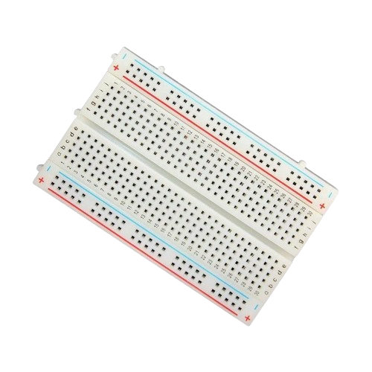
STEP 1:
Toggling the on-board LED of NodeMCU.
COMPONENT
ESP8266
BreadBoard
Github link:
https://github.com/MirzaSyazana/NodeMCU_WORKSHOP/blob/Step_1/LED_connect/LED_connect.ino

Slide 22
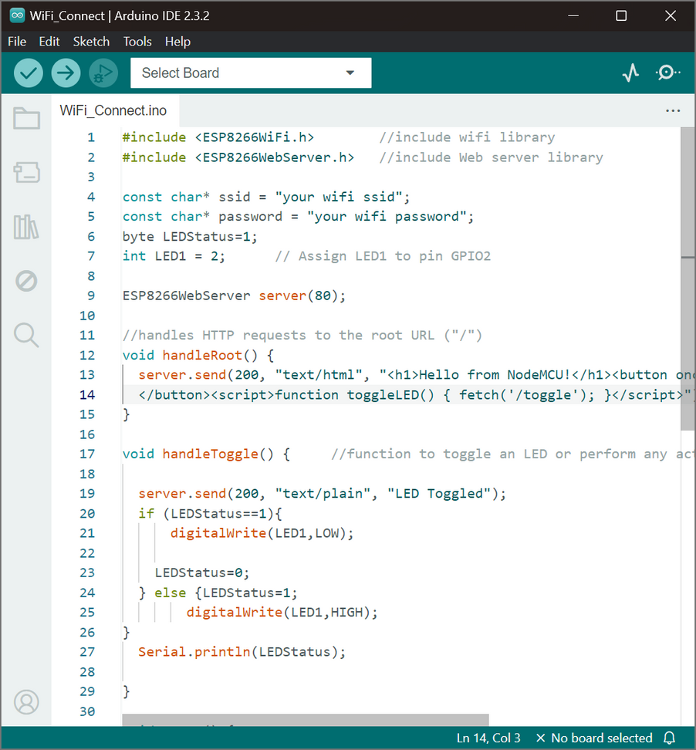
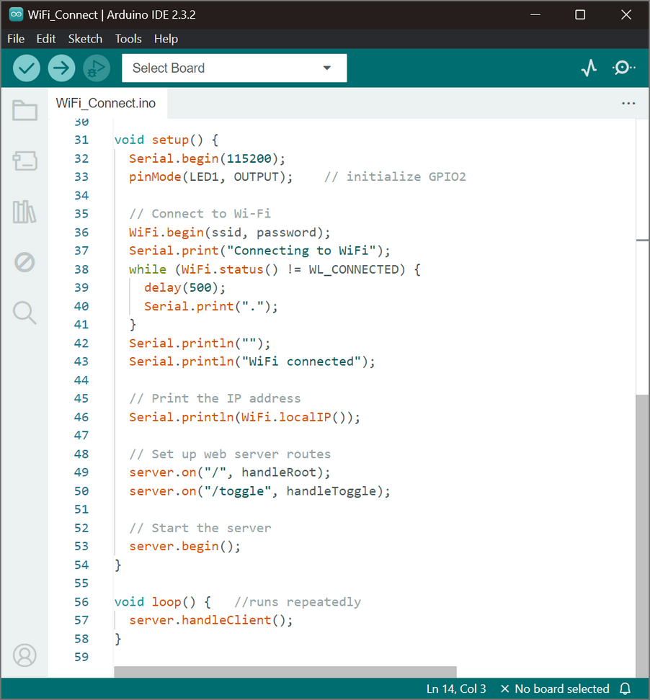
STEP 2:
Connect the NodeMCU to WiFi.
Github link:
https://github.com/MirzaSyazana/NodeMCU_WORKSHOP/blob/Step_2/connect_home_internet/connect_home_internet.ino

Slide 23
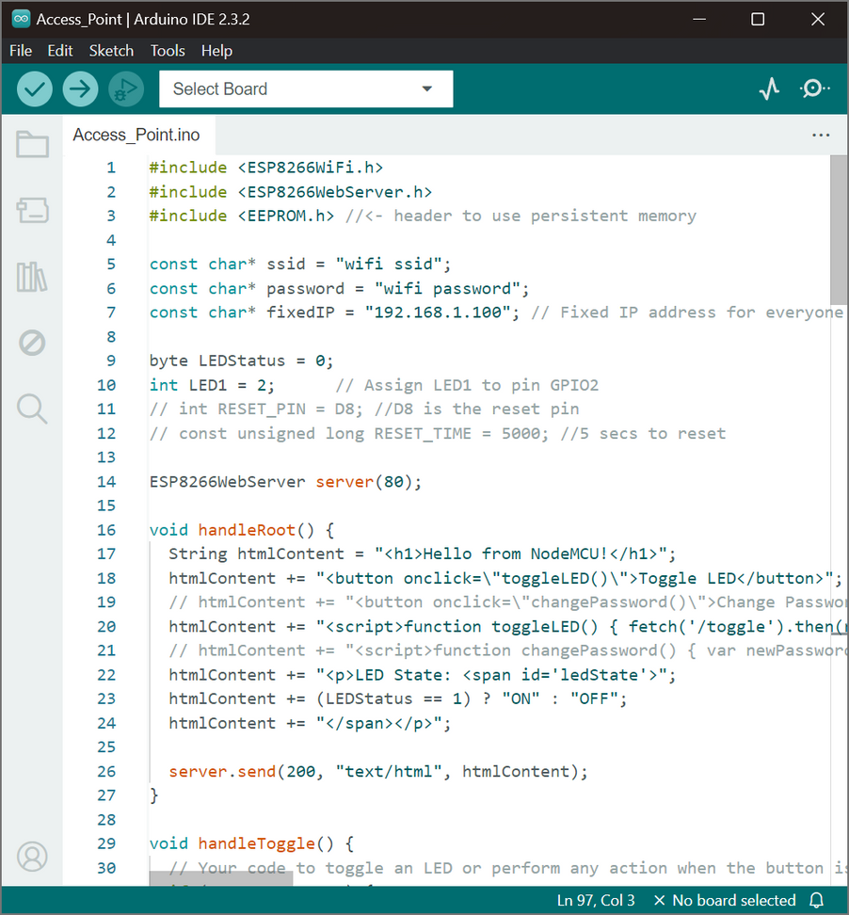
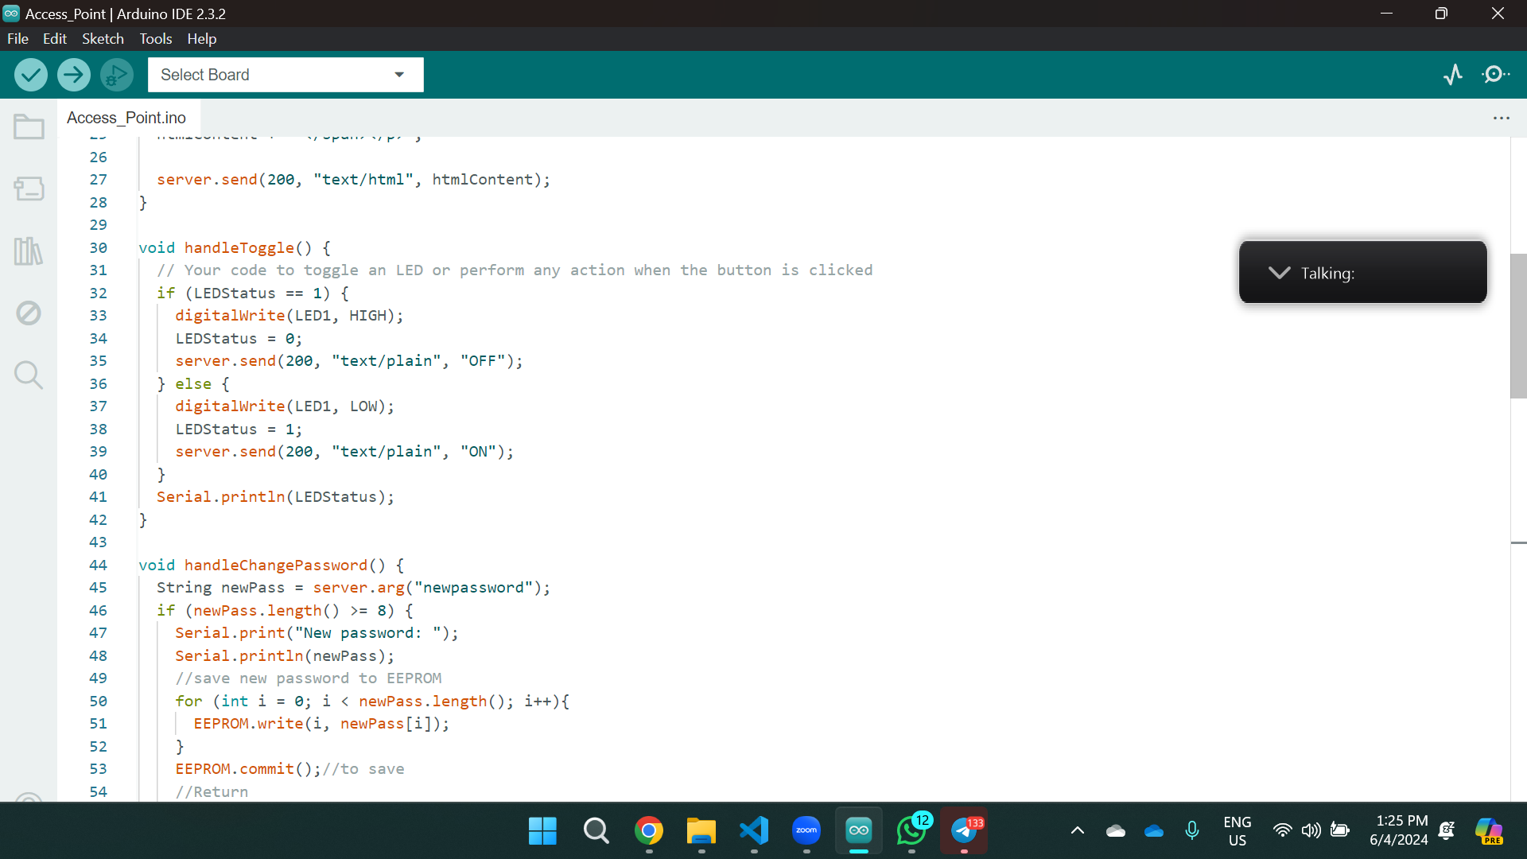
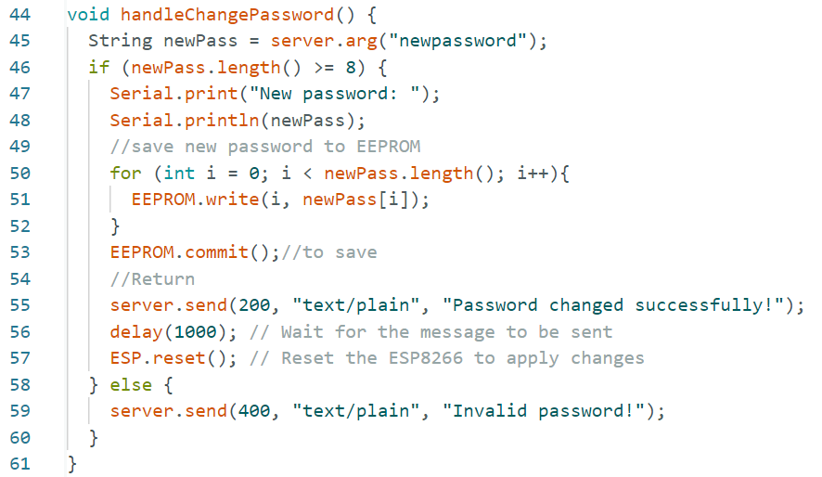
STEP 3:
Making the NodeMCU as an access point.
1
2
3
Github link:
https://github.com/MirzaSyazana/NodeMCU_WORKSHOP/blob/Step_3/Accesspoint_fixIP/Accesspoint_fixIP.ino

Slide 24
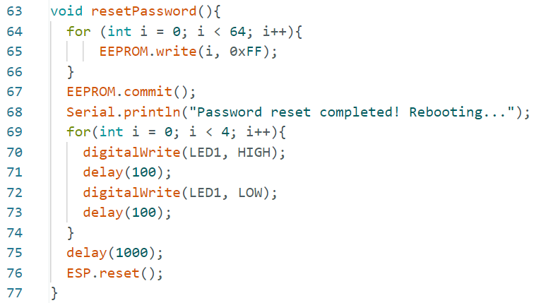
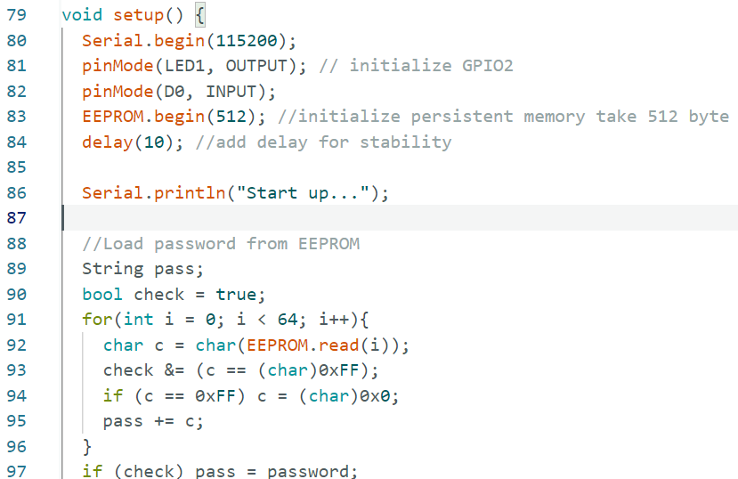
STEP 3:
Making the NodeMCU as an access point.
4
5
Github link:
https://github.com/MirzaSyazana/NodeMCU_WORKSHOP/blob/Step_3/Change_pass/Change_pass.ino

Slide 25
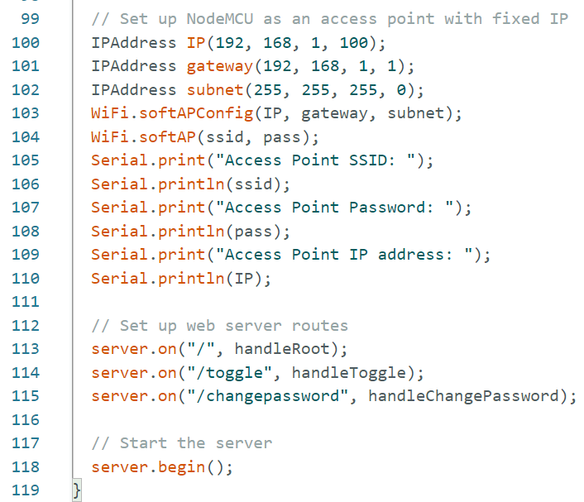
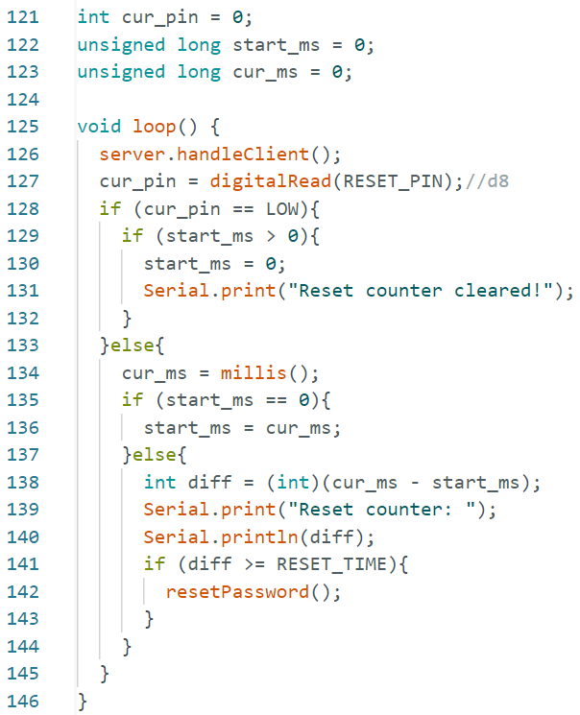
STEP 3:
Making the NodeMCU as an access point.
6
7

Slide 26
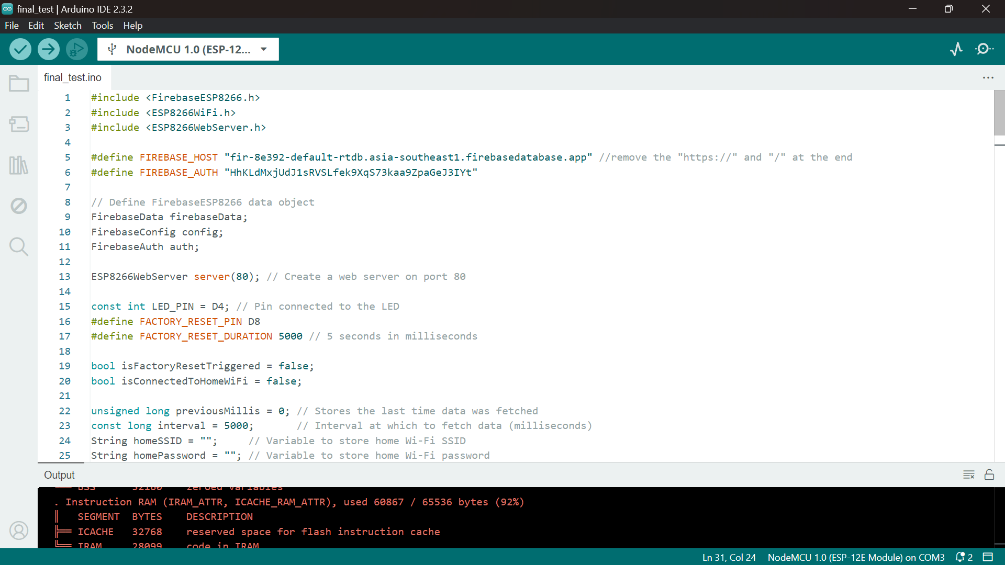
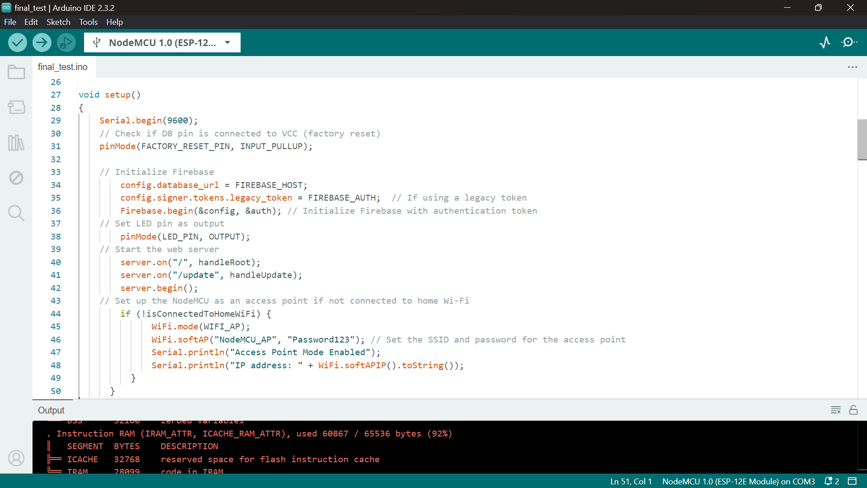
STEP 4:
Connect the NodeMCU to the Firebase
Github link:
https://github.com/MirzaSyazana/NodeMCU_WORKSHOP/blob/Step_4/connect_to_firebase/connect_to_firebase.ino

Slide 27
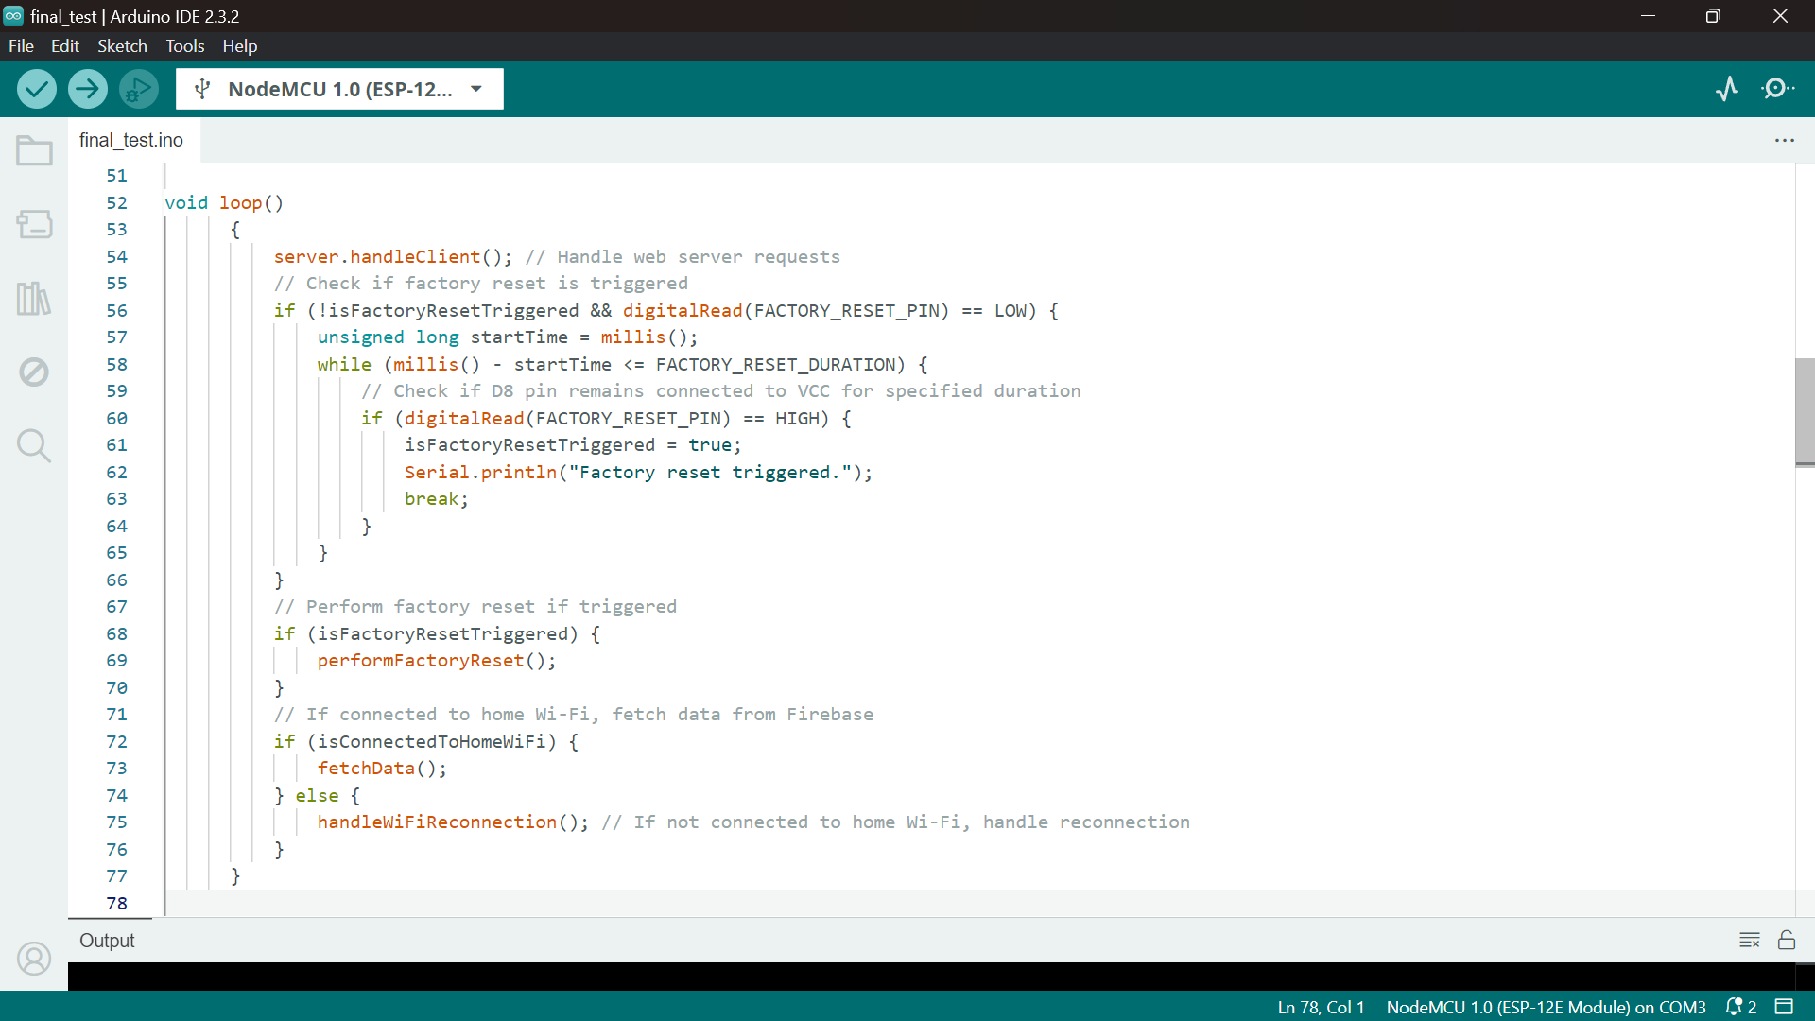
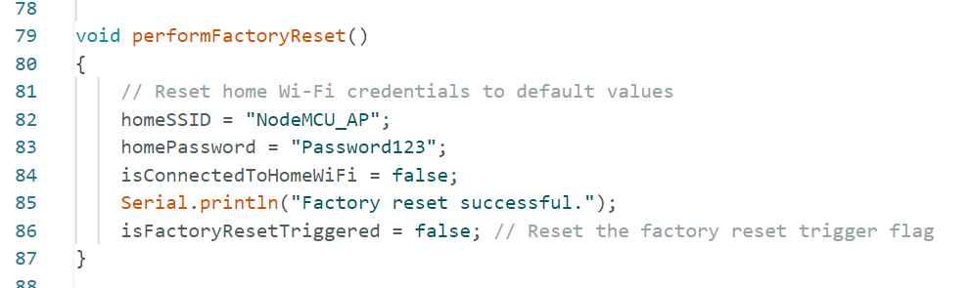
STEP 4:
Connect the NodeMCU to the Firebase

Slide 28
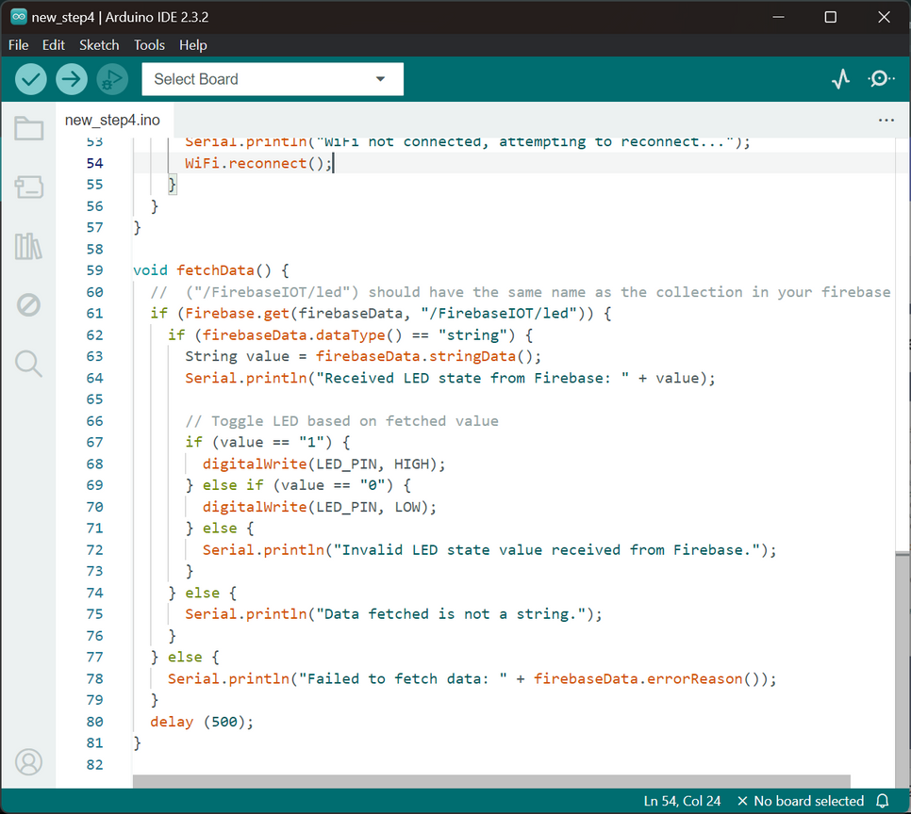
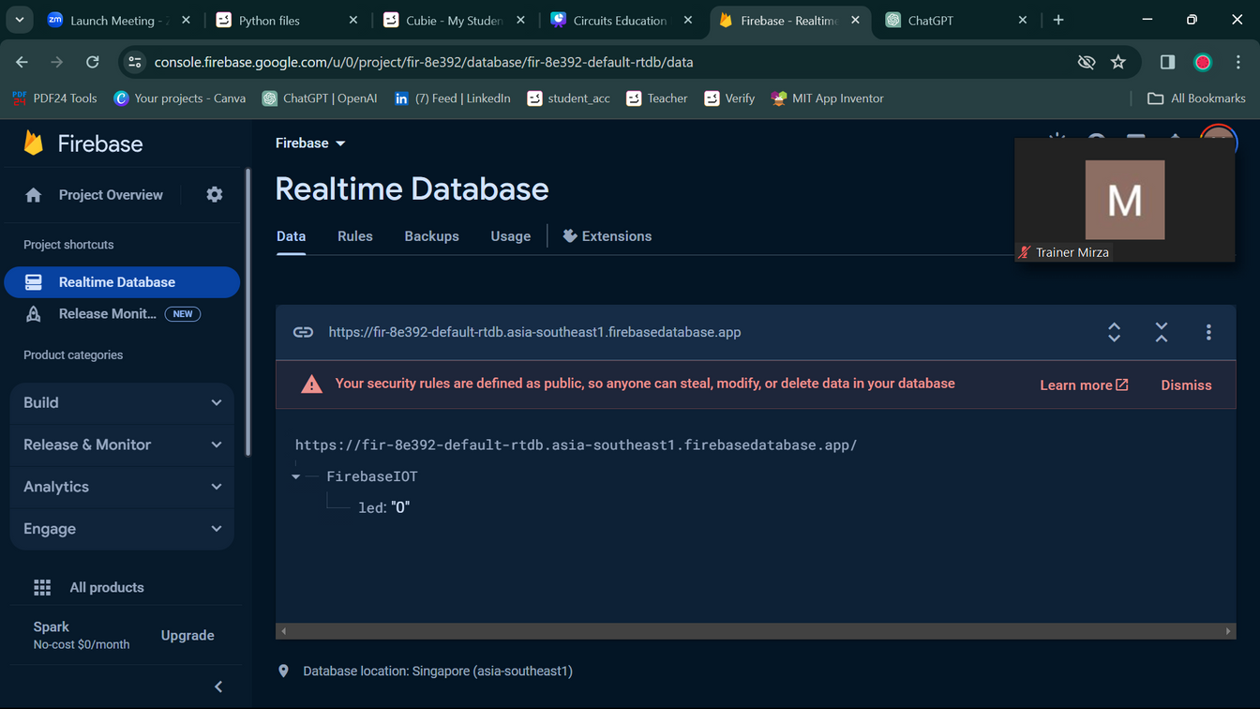
STEP 4:
Connect the NodeMCU to the Firebase
Must be the same as your firebase collection

Slide 29
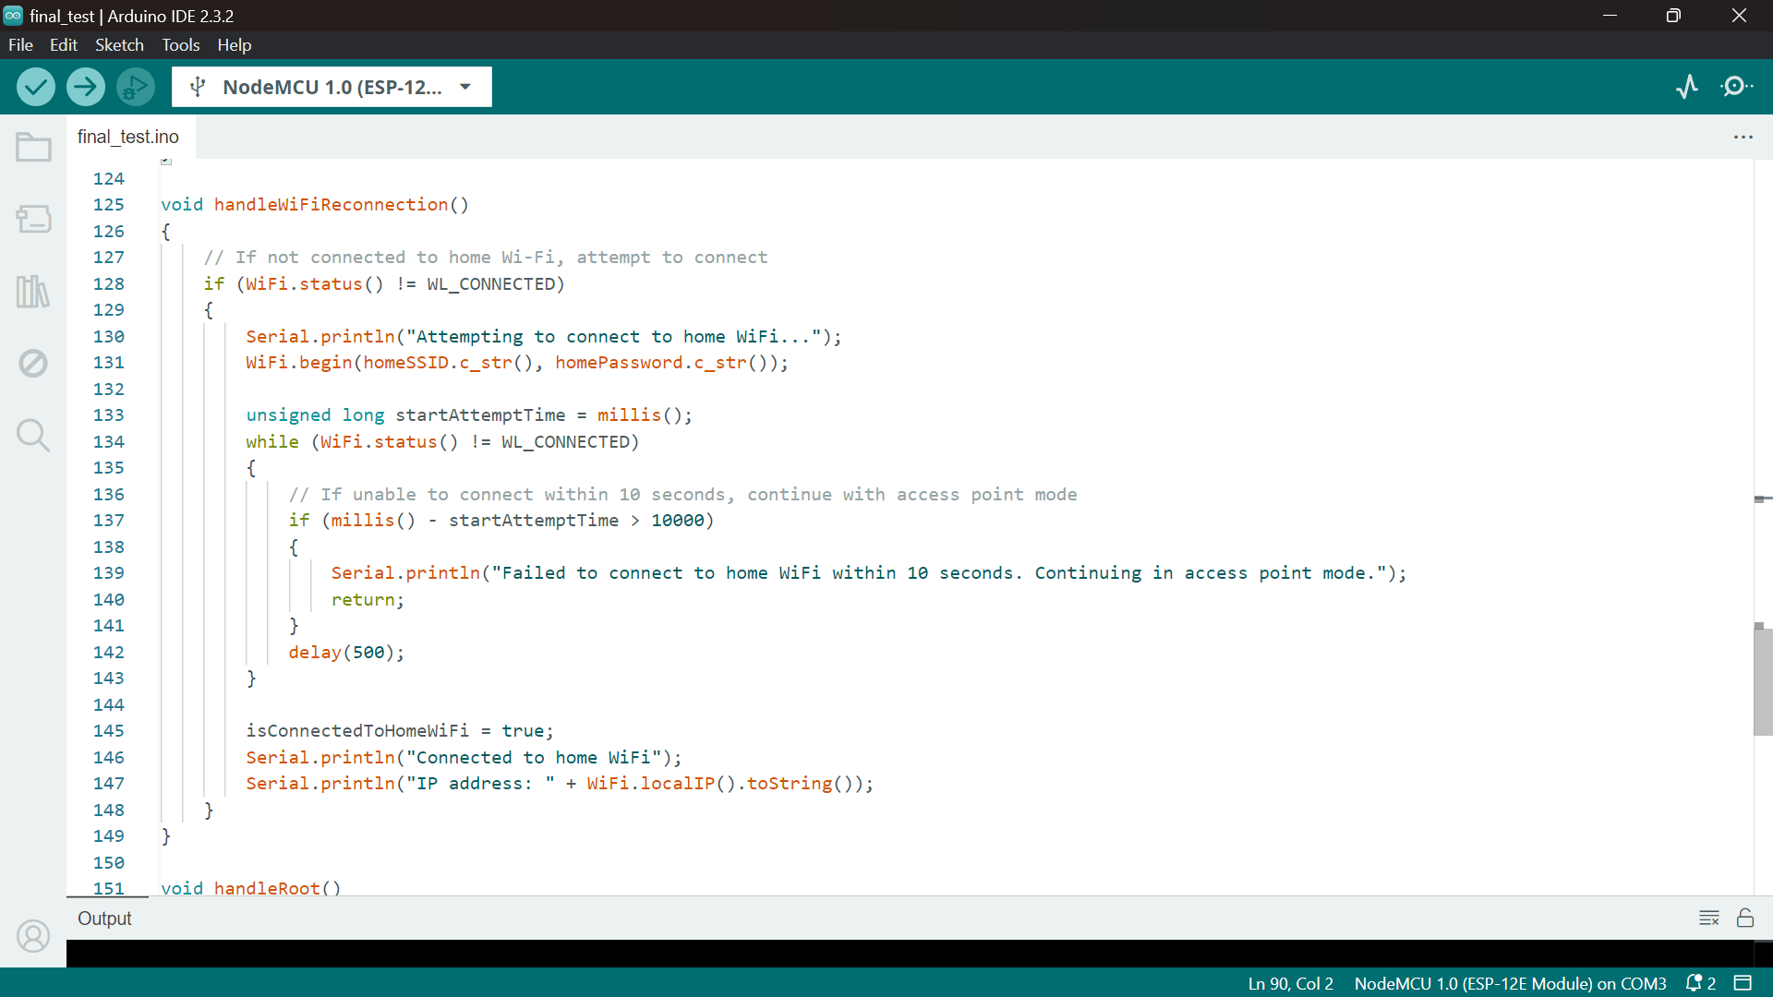
STEP 4:
Connect the NodeMCU to the Firebase
Github link:
https://github.com/MirzaSyazana/NodeMCU_WORKSHOP/blob/Step_4/final_test/final_test.ino

Slide 30
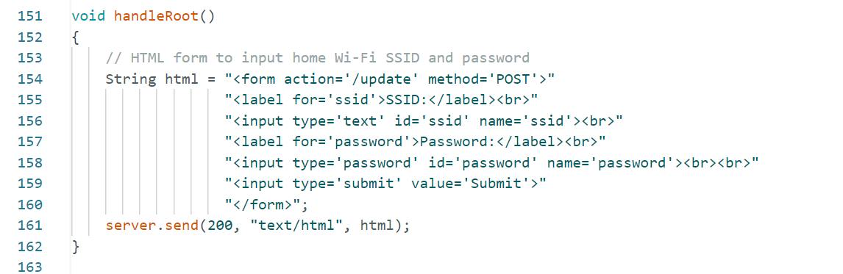
STEP 4:
Connect the NodeMCU to the Firebase

Slide 31
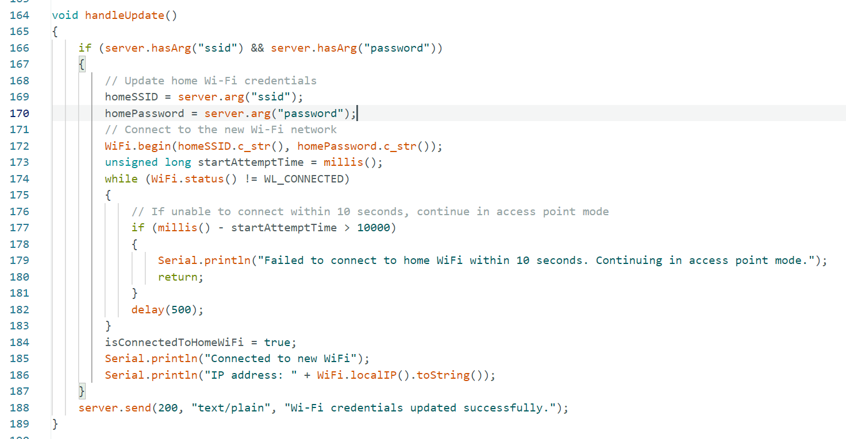
STEP 4:
Connect the NodeMCU to the Firebase

Slide 32
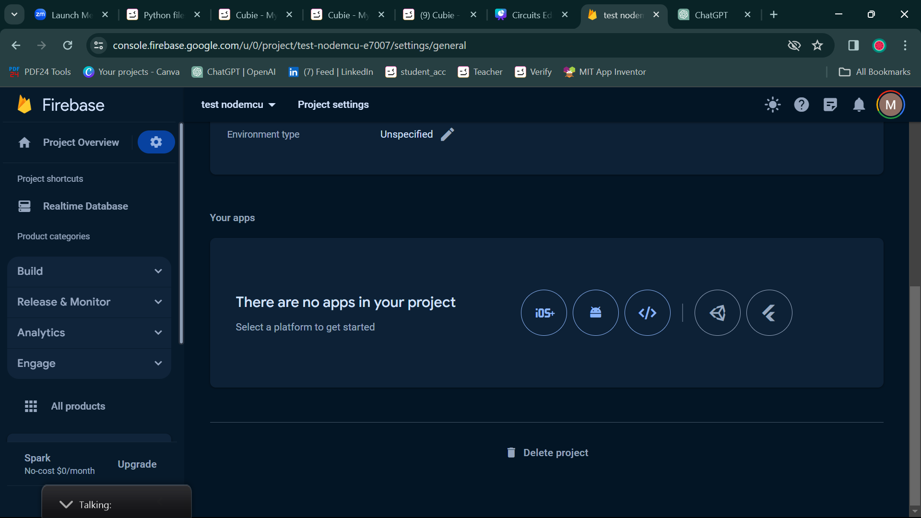

CREATING AN APP IN FIREBASE
Go to project overview > Your Apps > choose “</>”

Slide 33
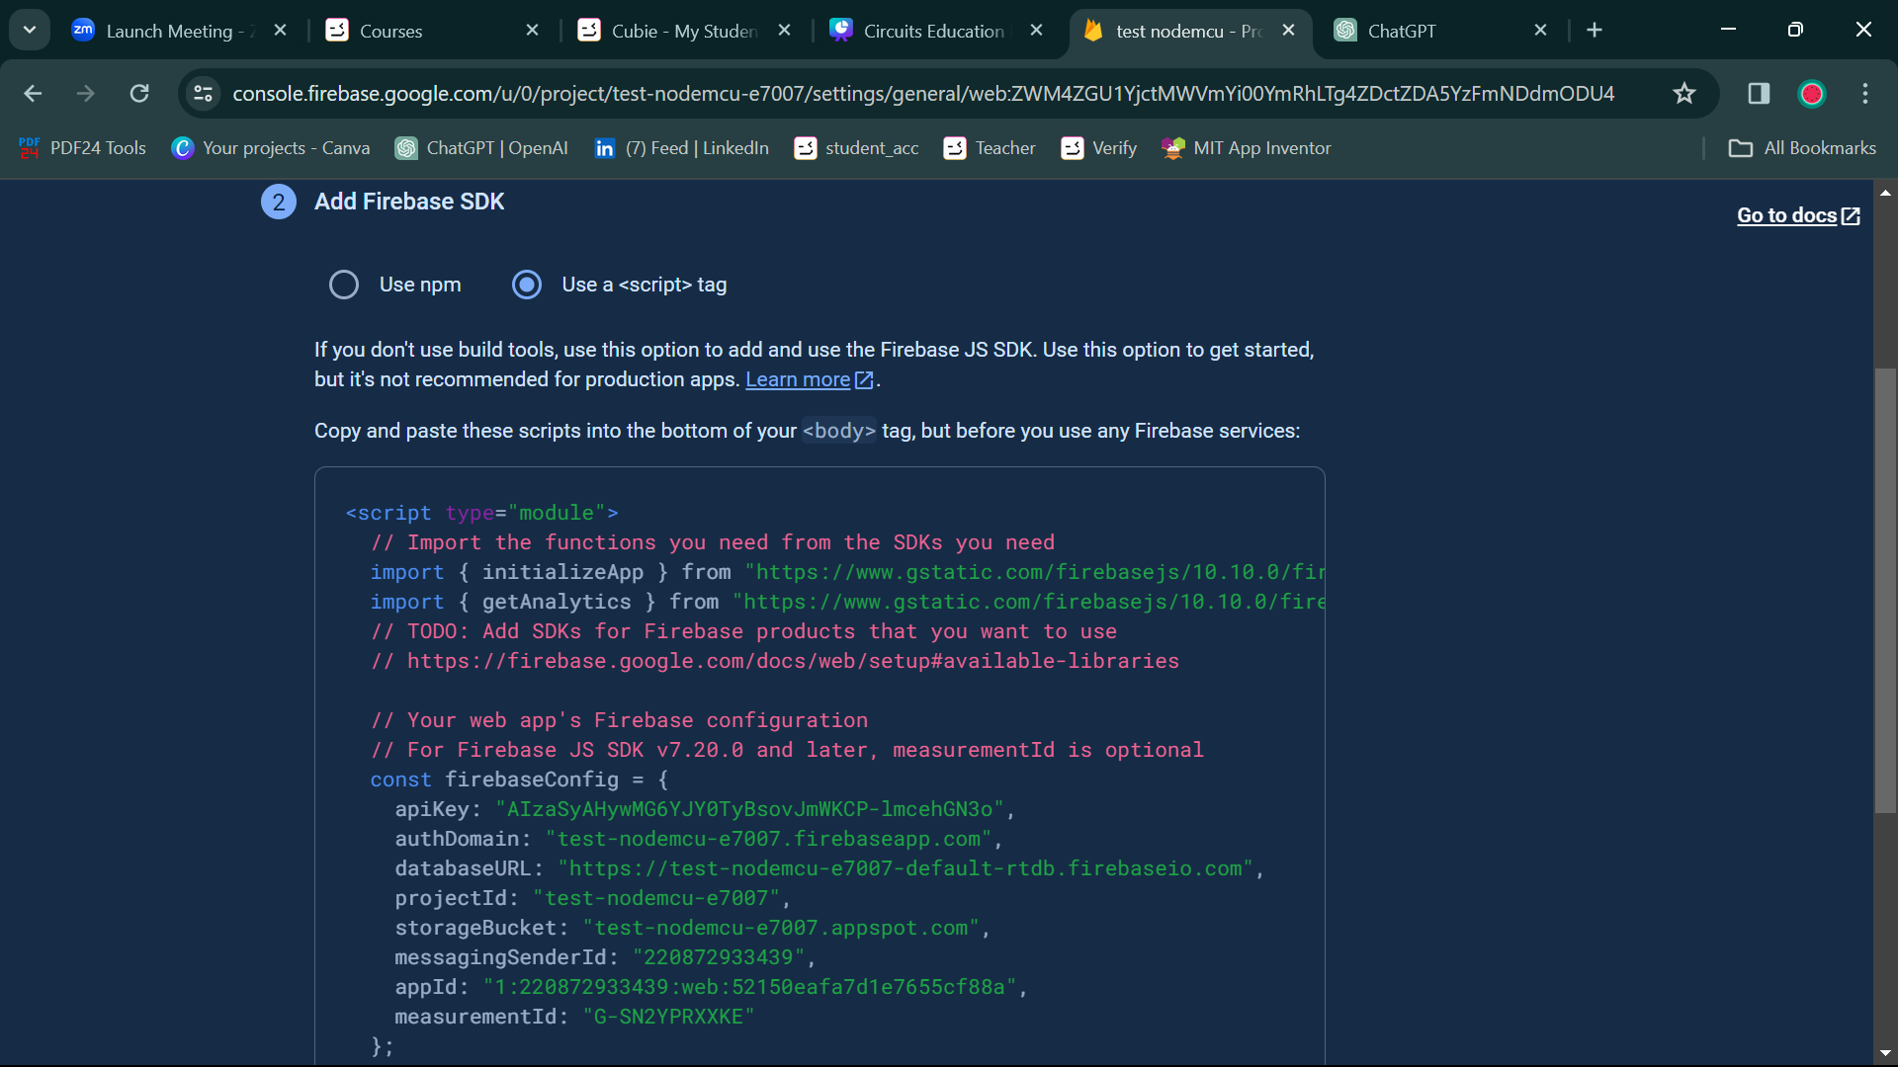
CREATING AN APP IN FIREBASE
In step 2: Choose the “Use <script> tag.
Copy the firebase configuration and paste it inside your html <script> tag.

Slide 34
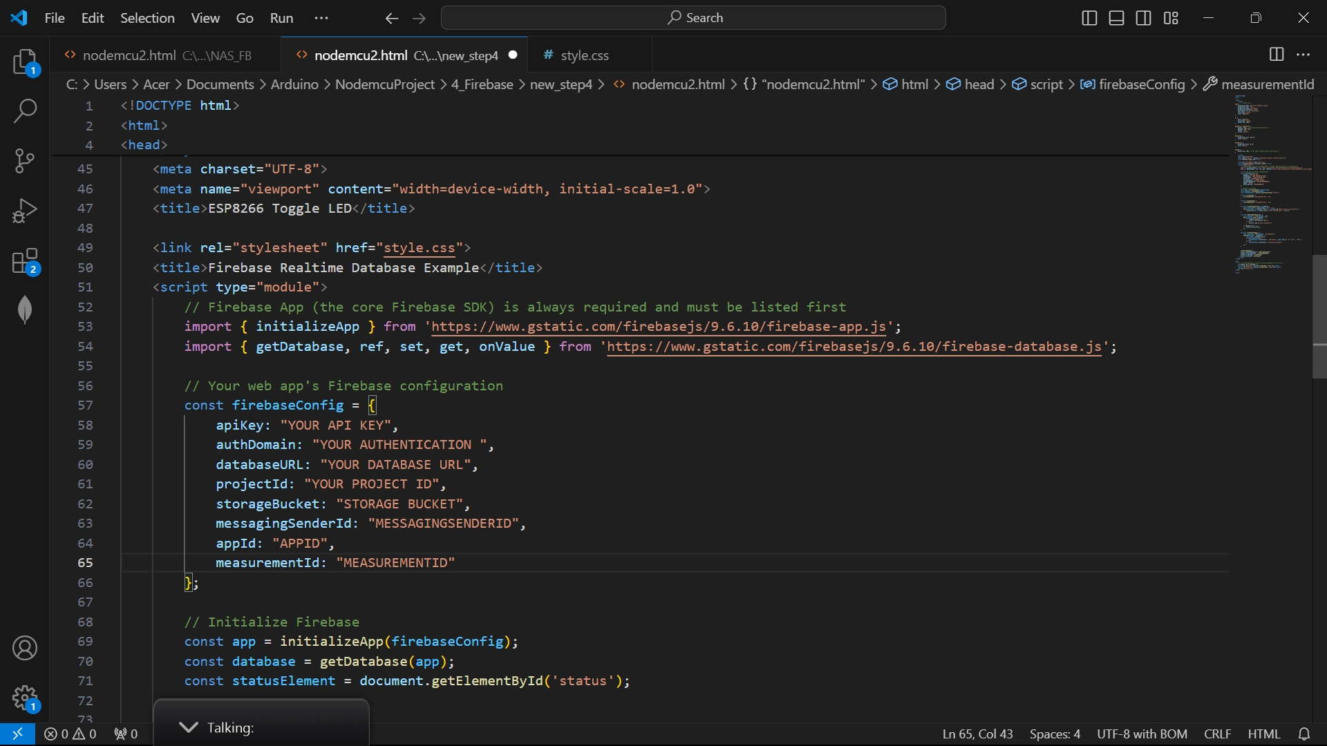

CREATING A WEB PAGE FOR UI
remember your <script> tag? copy and paste it here!

Slide 35
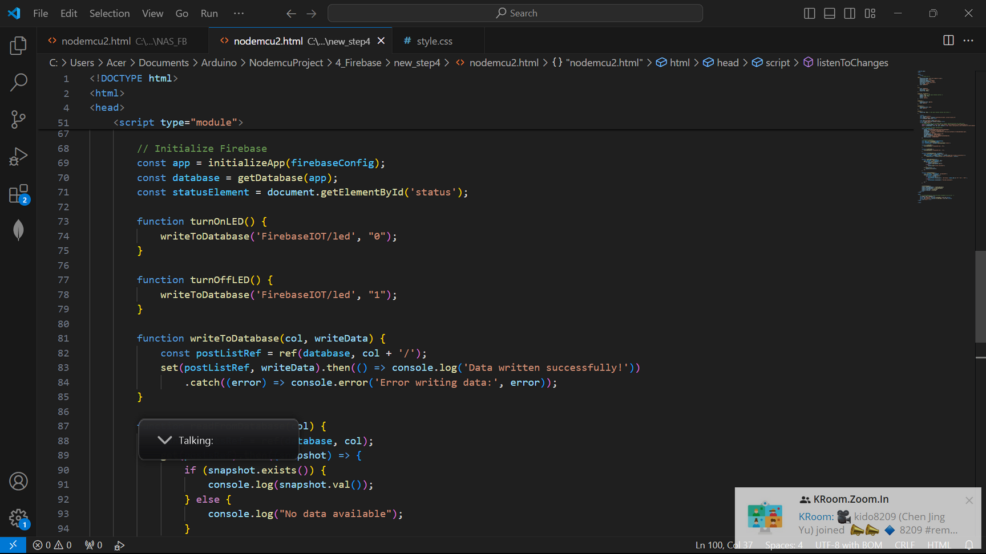
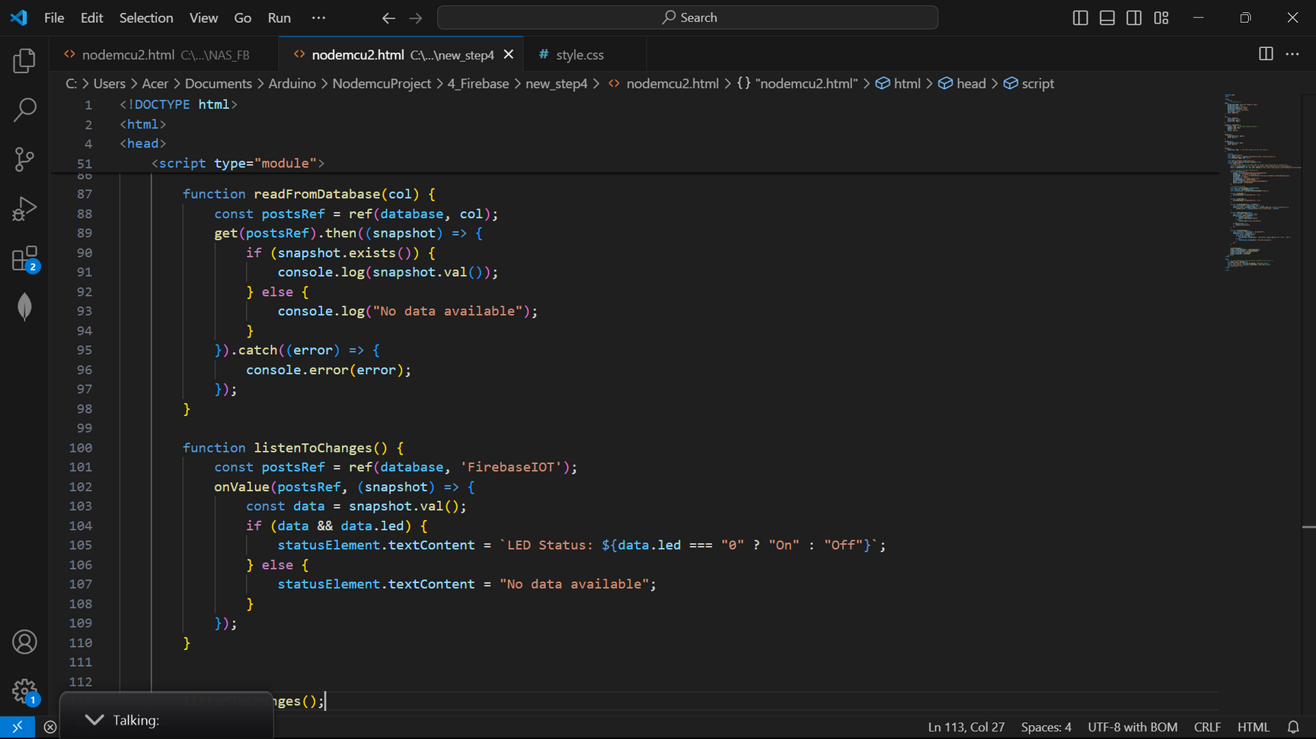
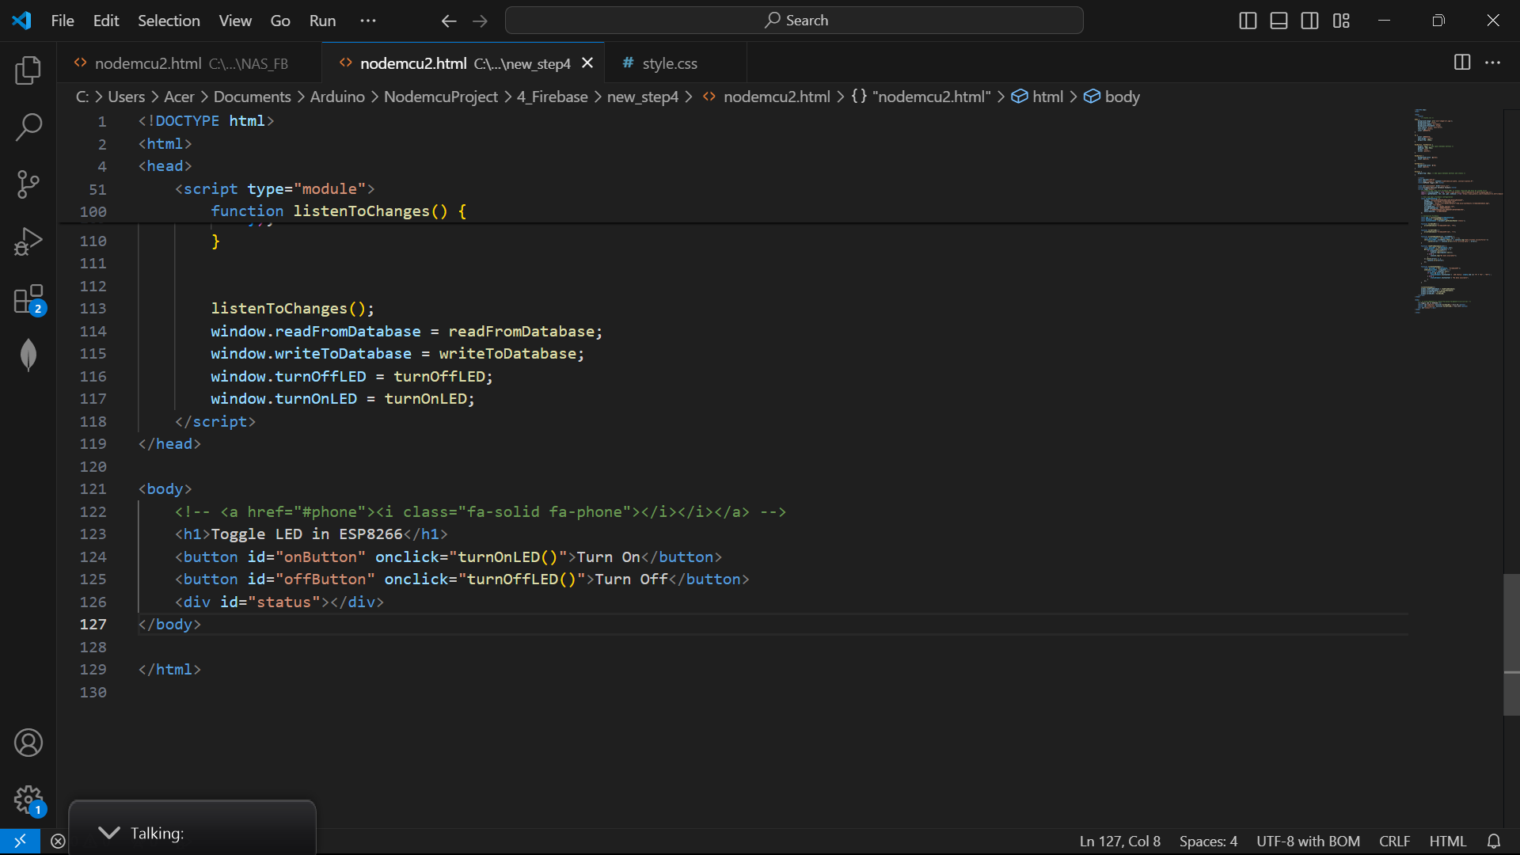
CREATING A WEB PAGE FOR UI
FUNCTIONS INSIDE HTML FILE:
1
2
3
Github link:
https://github.com/MirzaSyazana/NodeMCU_WORKSHOP/blob/main/FIREBASE_CREDENTIAL.html

Slide 36
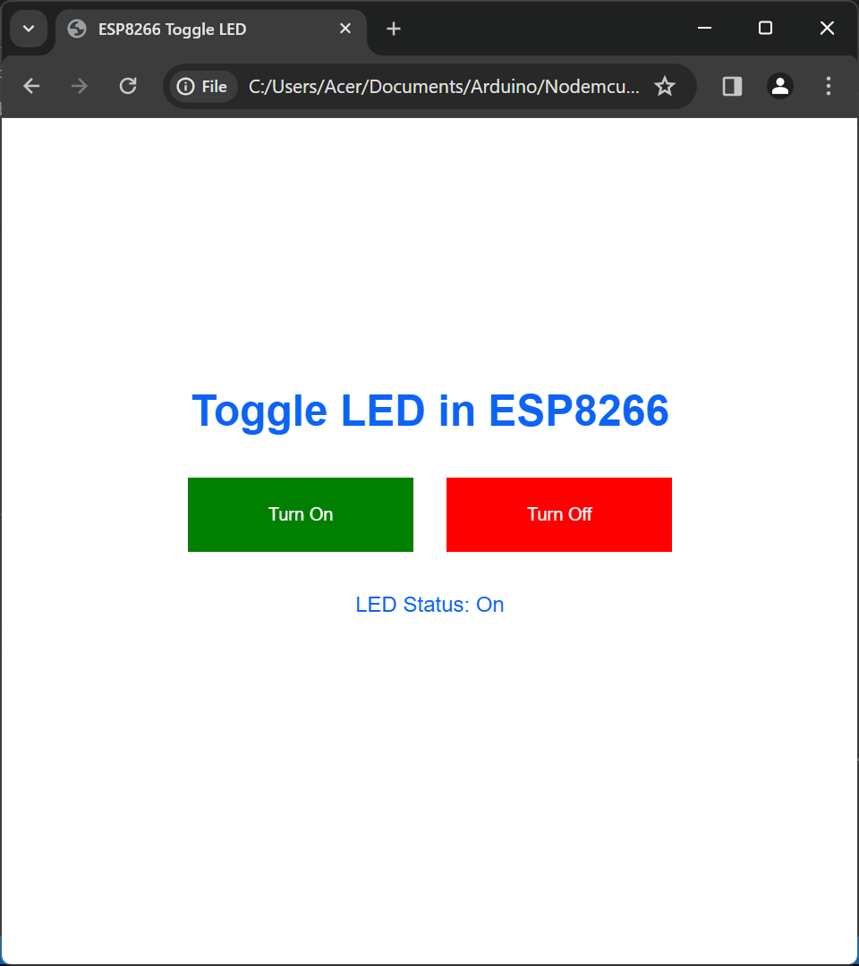
Now.. MAKE YOUR HTML PAGE TO BE USER FRIENDLY!
HINT: You need to add button for the toggle LED inside your <body> tag!
Link folder : https://drive.google.com/drive/folders/1YzubzNJKii9R1xIqko5APrKMOCOhg2xm?usp=sharing

Slide 37
Firebase link : https://trialmcu-b109a-default-rtdb.asia-southeast1.firebasedatabase.app/
auth key : UXeUN4Swyqc6W0dQlPmf8TopG6kT3zczD99nrsg0
Link library : https://github.com/links2004/arduinowebsockets/tree/master

